Slide 1
Platinum and Palladium Printing
Workshop Examples

Slide 2
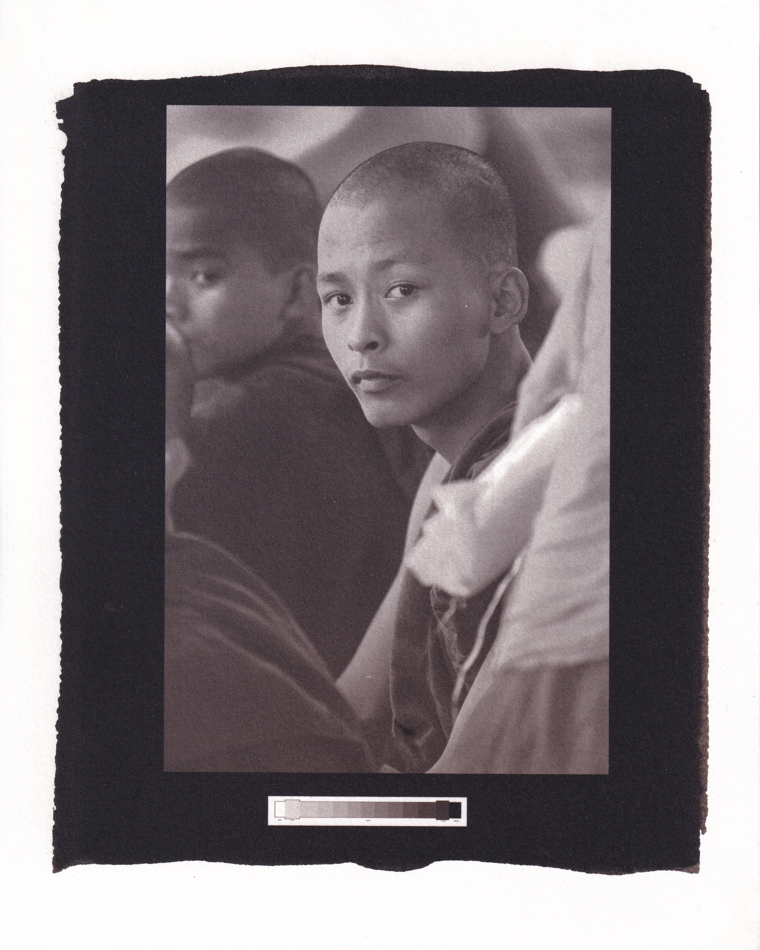

Slide 3
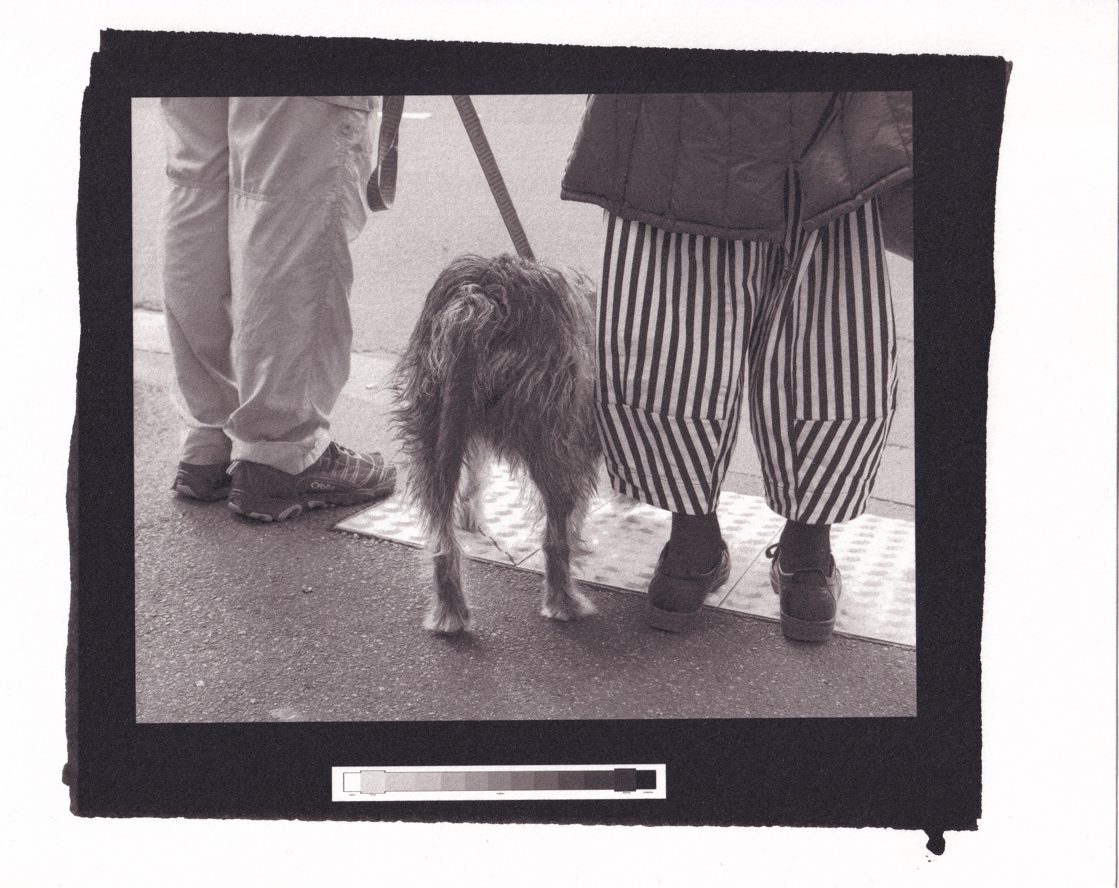

Slide 4
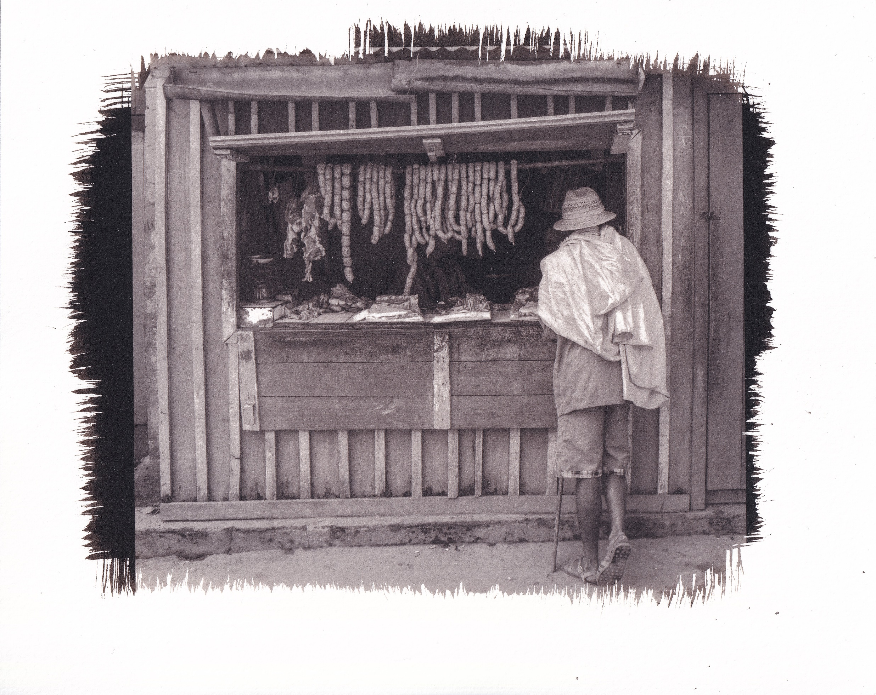

Slide 5
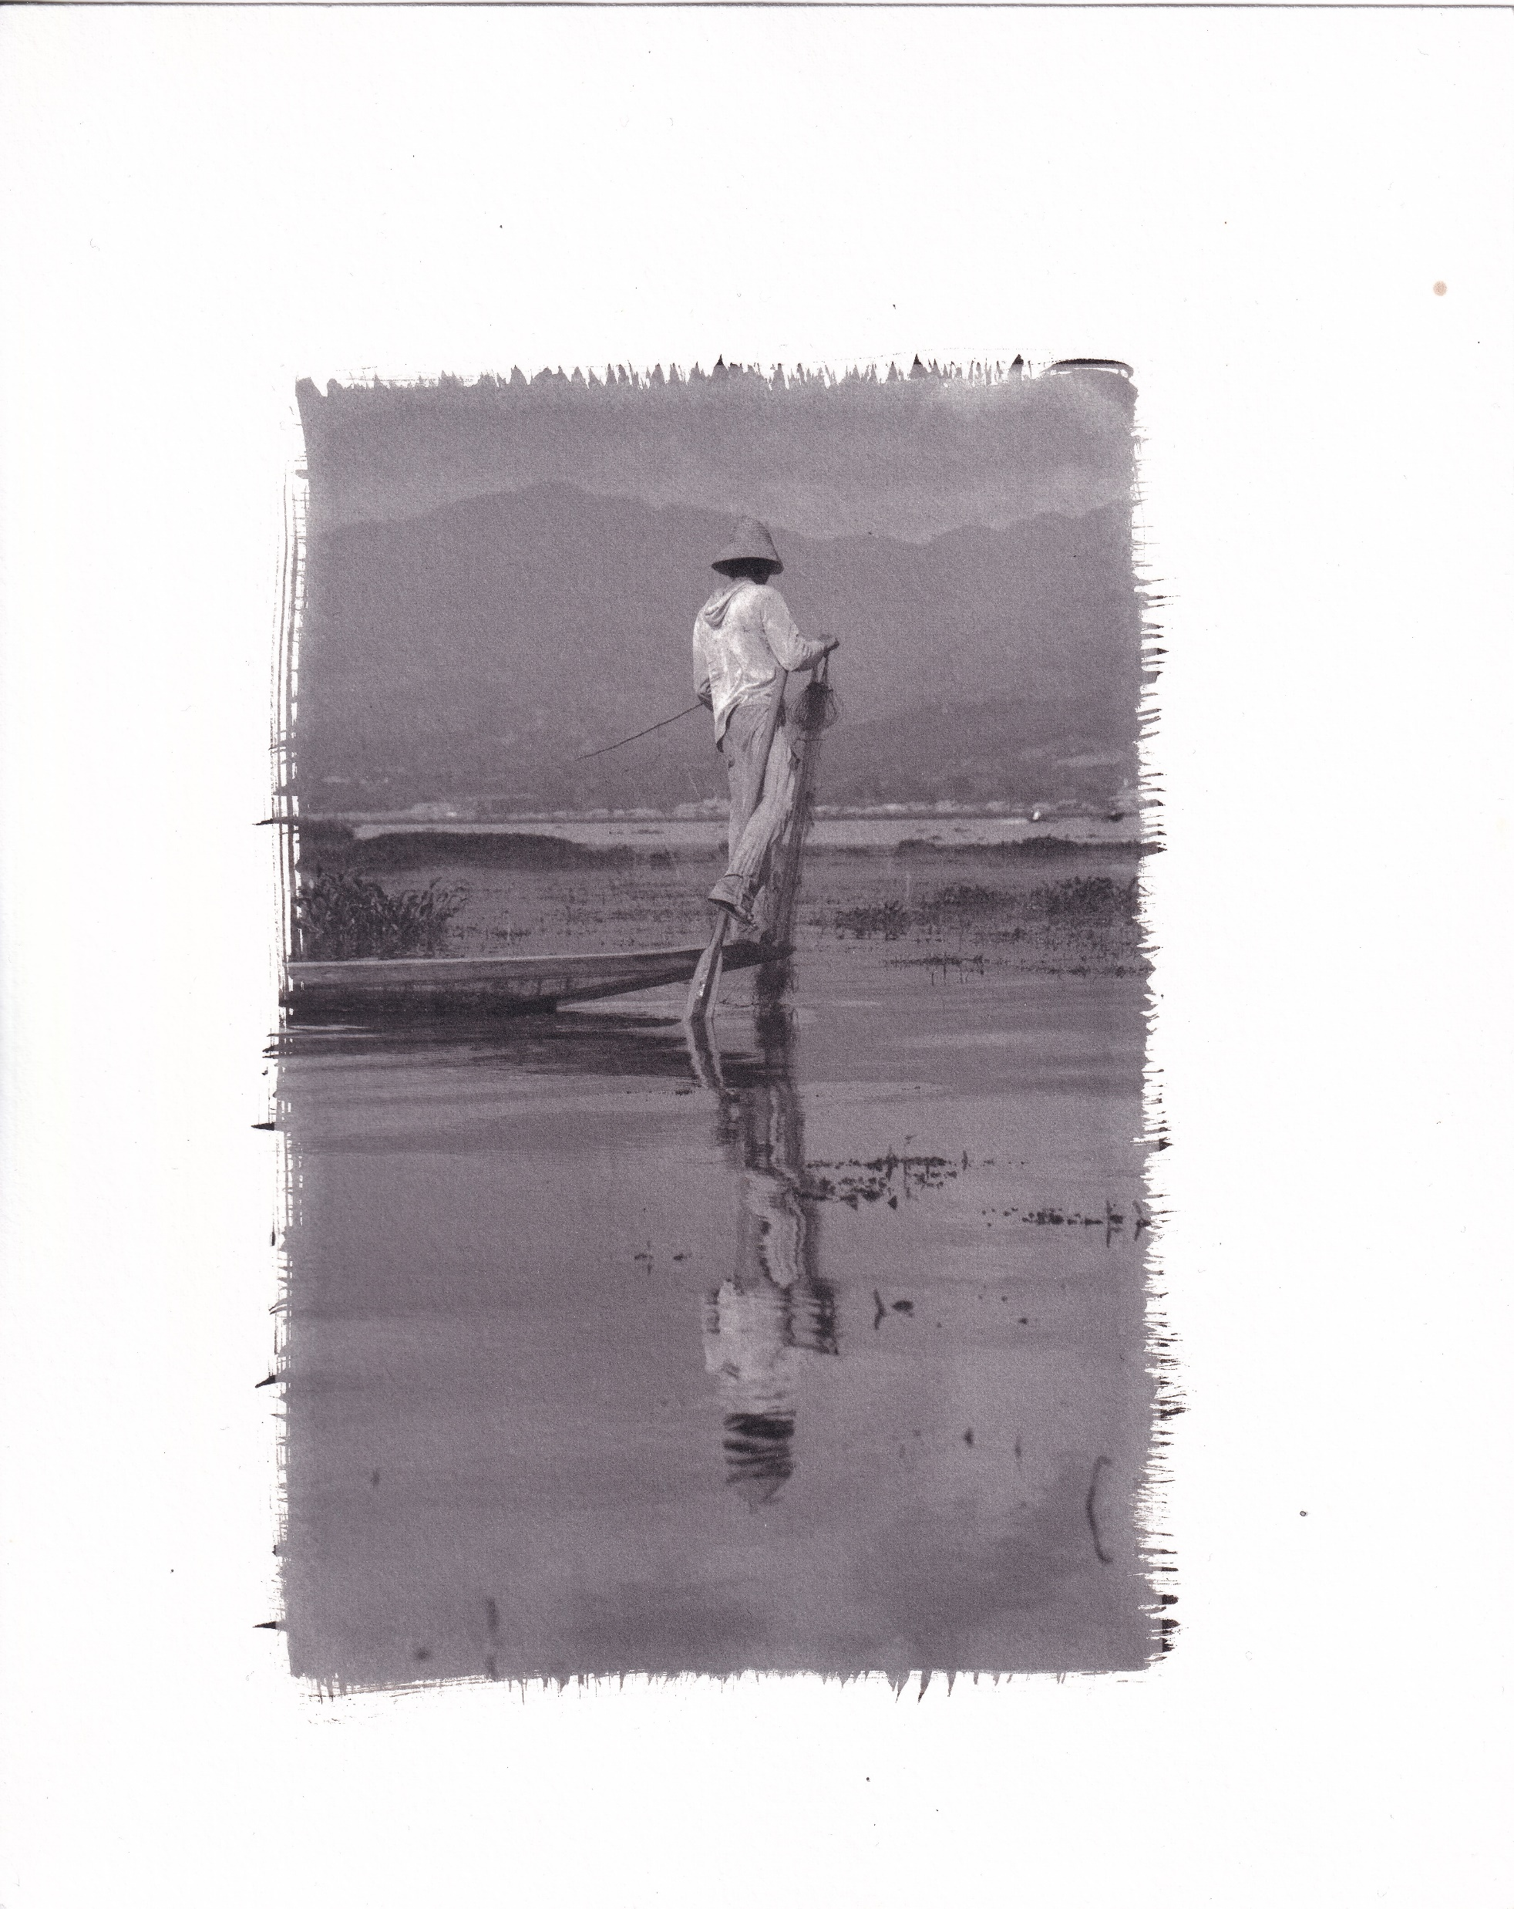

Slide 6
Inside the Shell
Some of the Challenges of Platinum and Palladium Printing

Slide 7
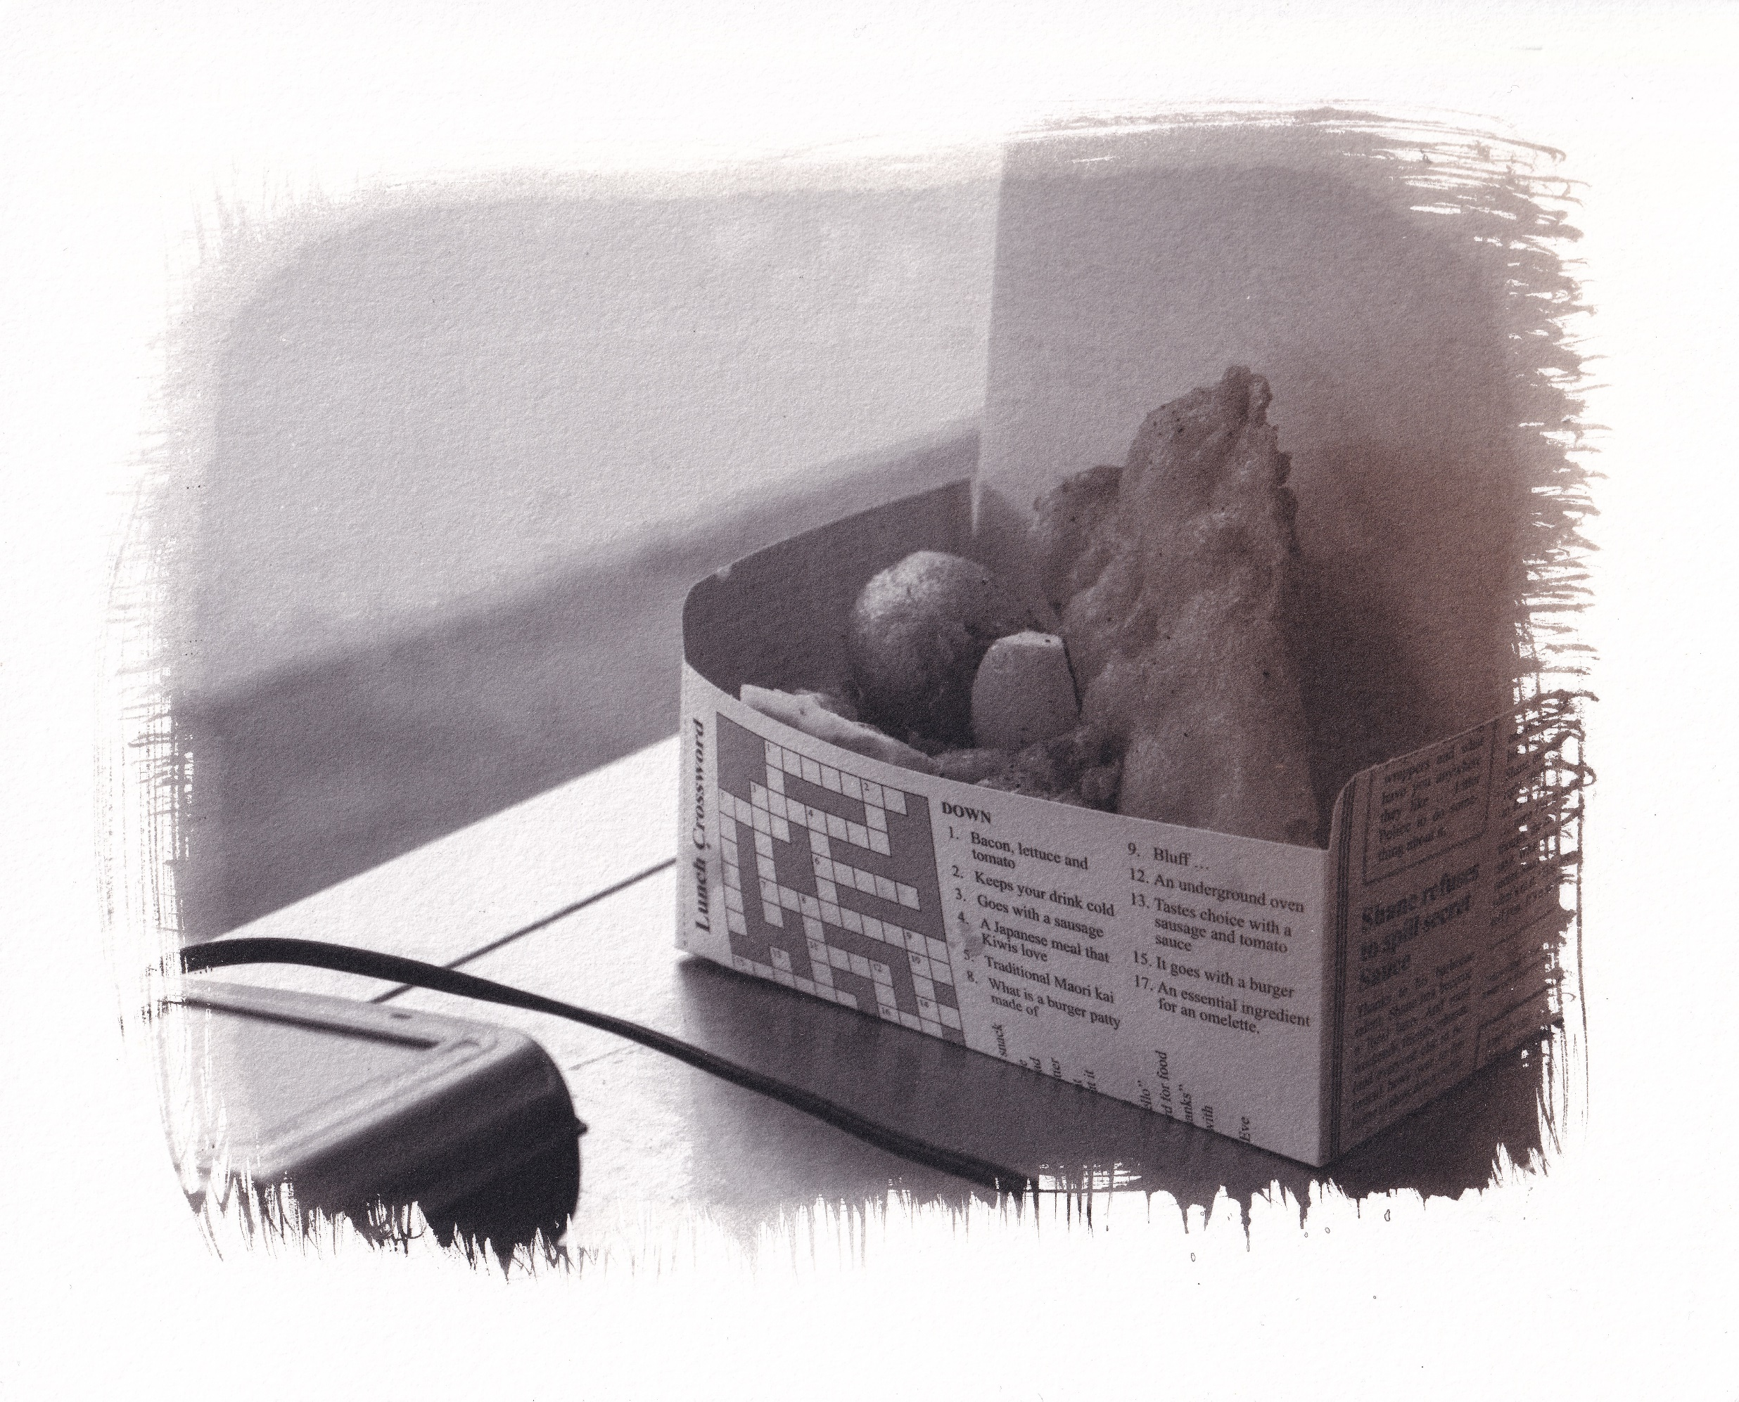

Slide 8
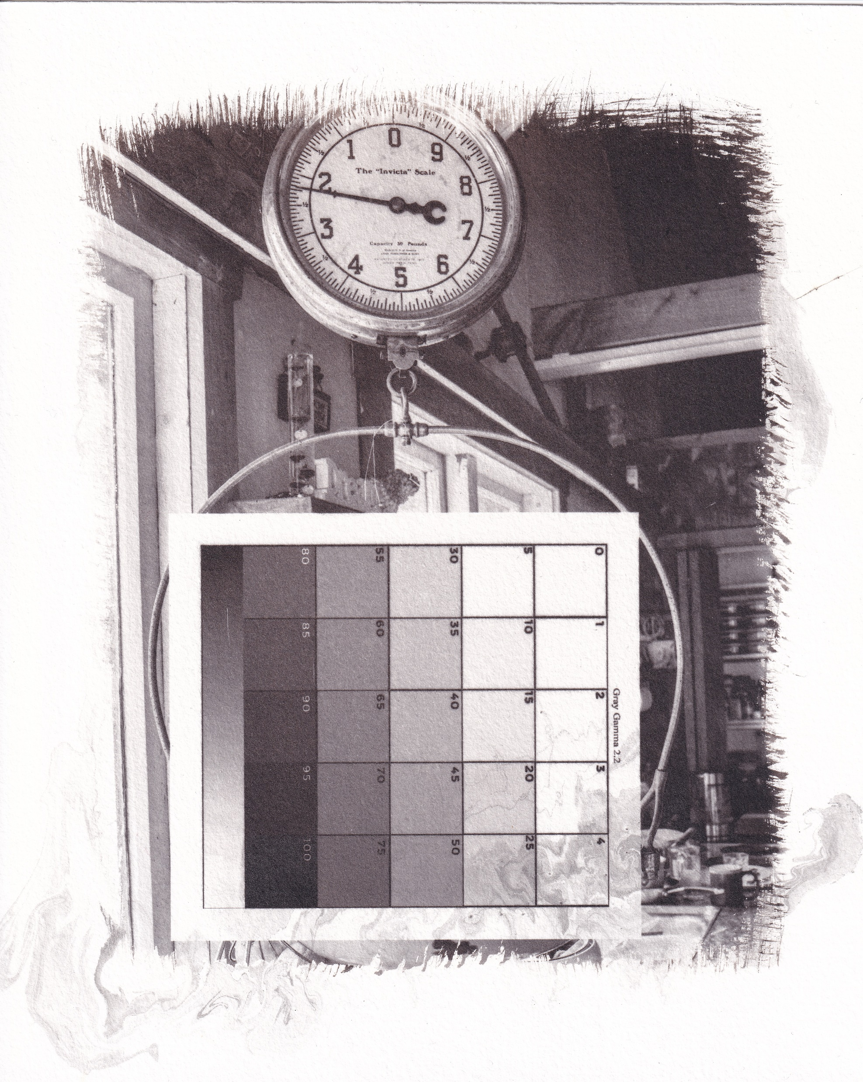

Slide 9
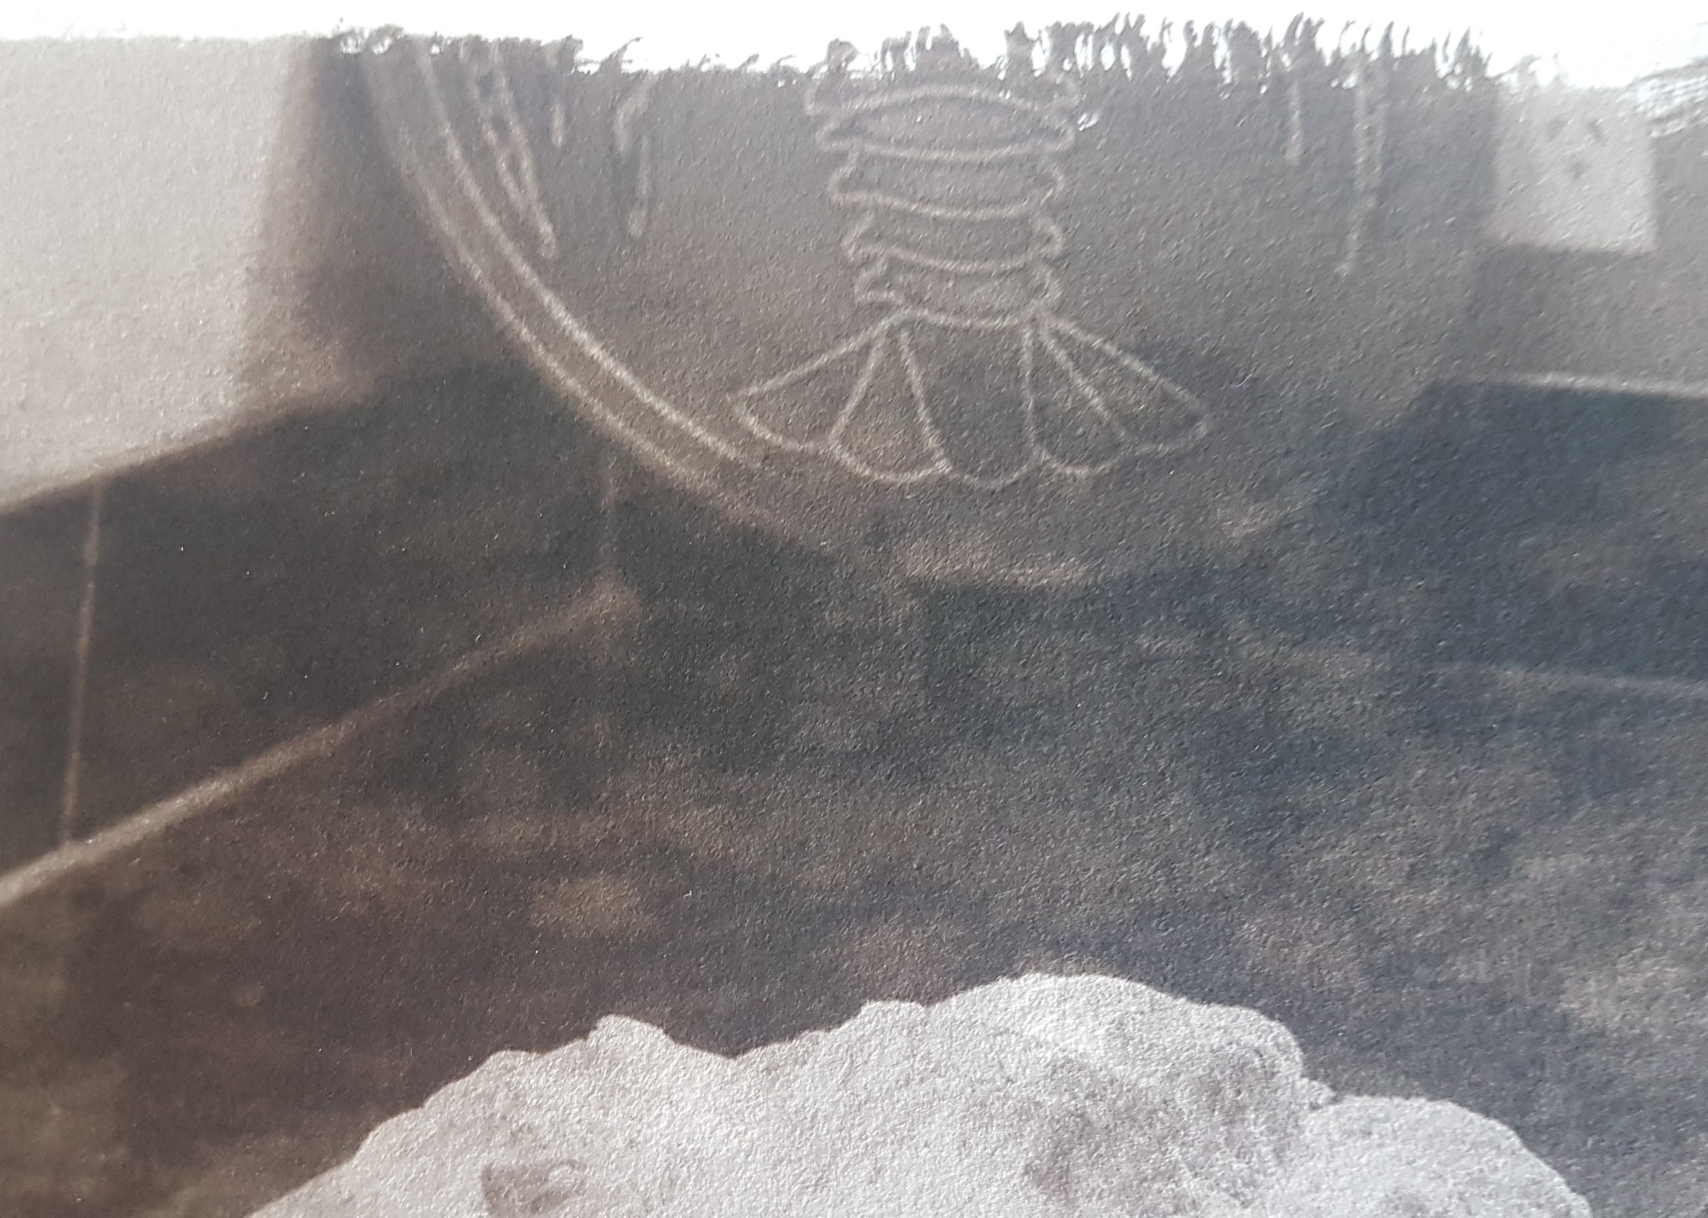

Slide 10
Inside the Shell
Images that just did not work!

Slide 11
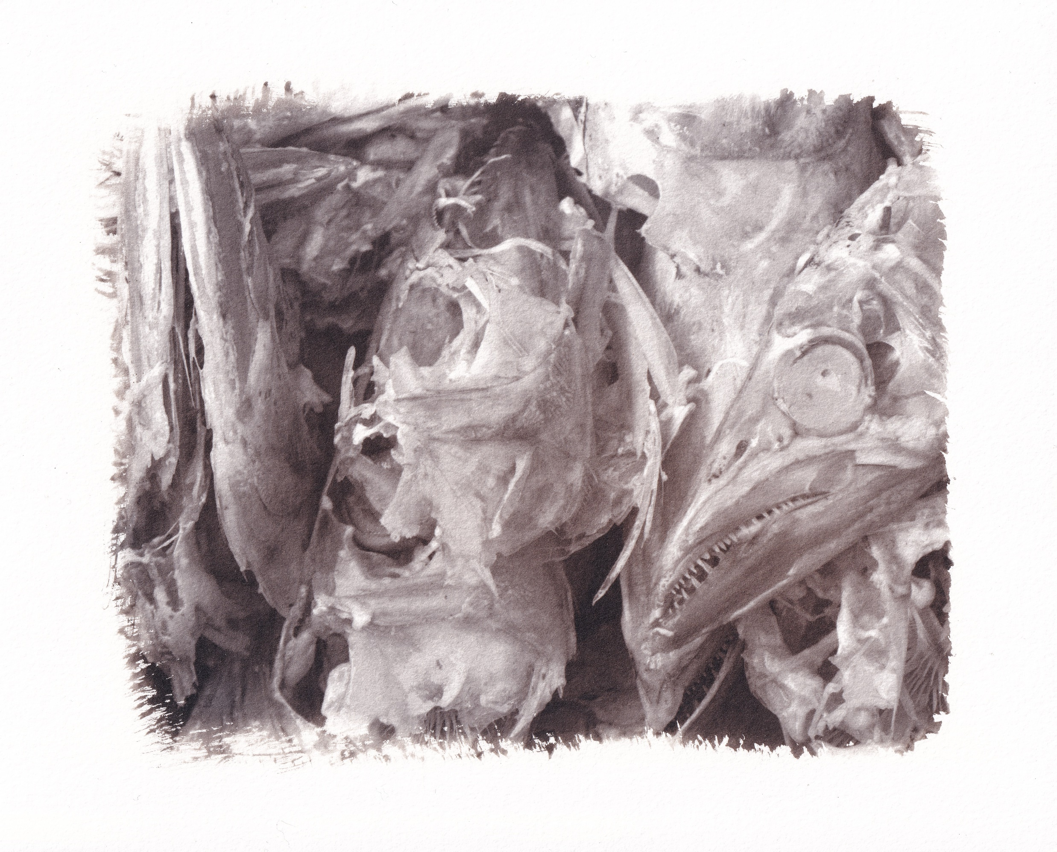

Slide 12
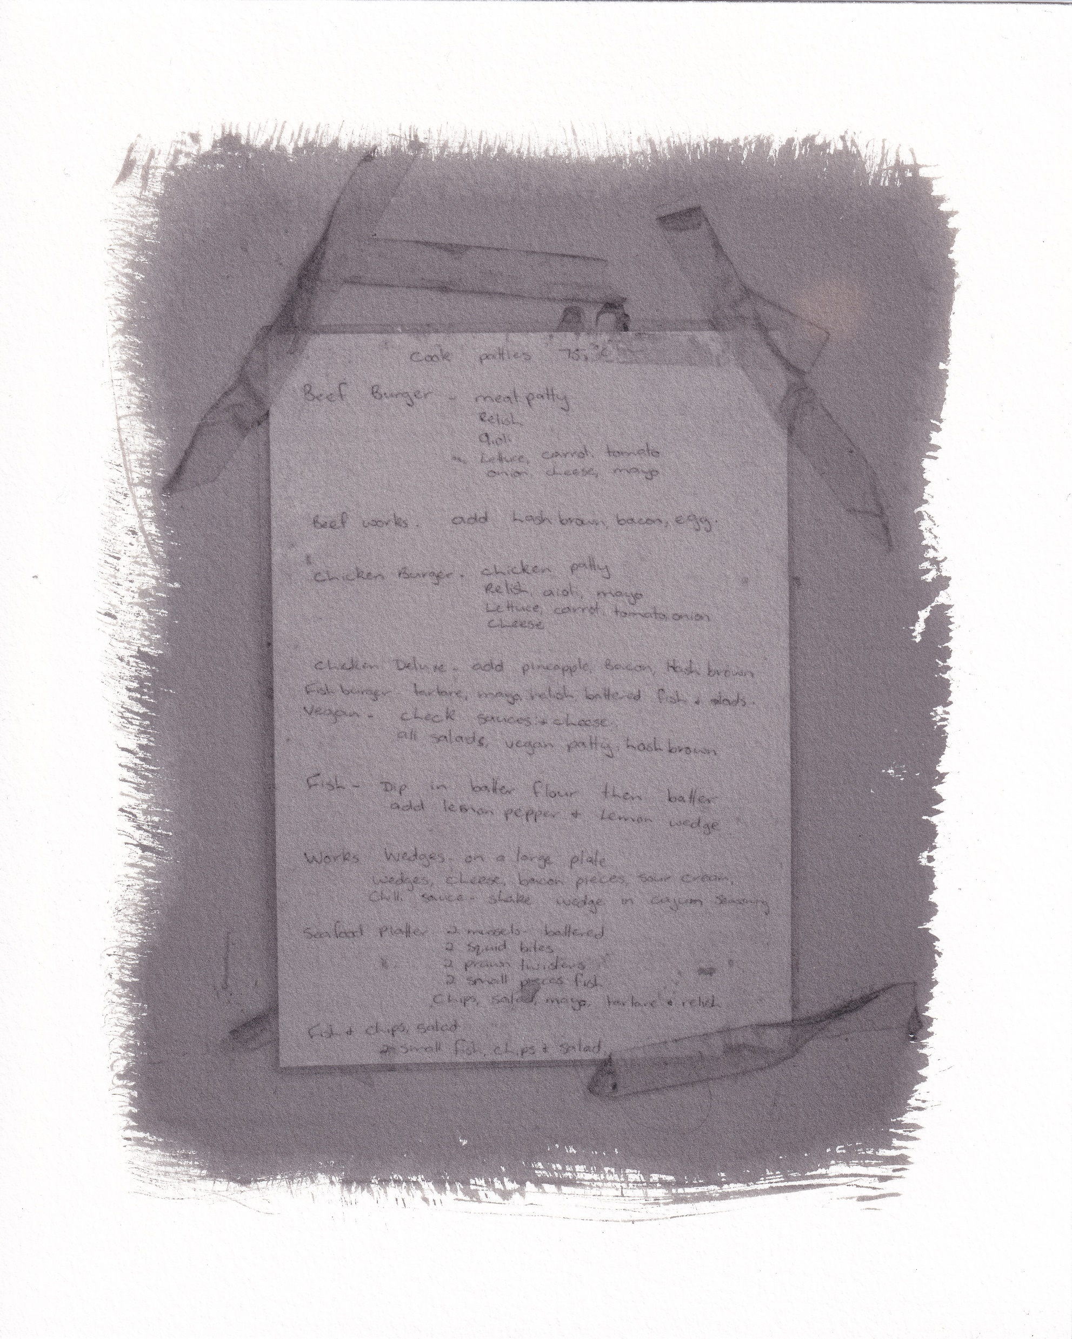

Slide 13
Inside the Shell
Some examples that were printed but are not in the Exhibition

Slide 14
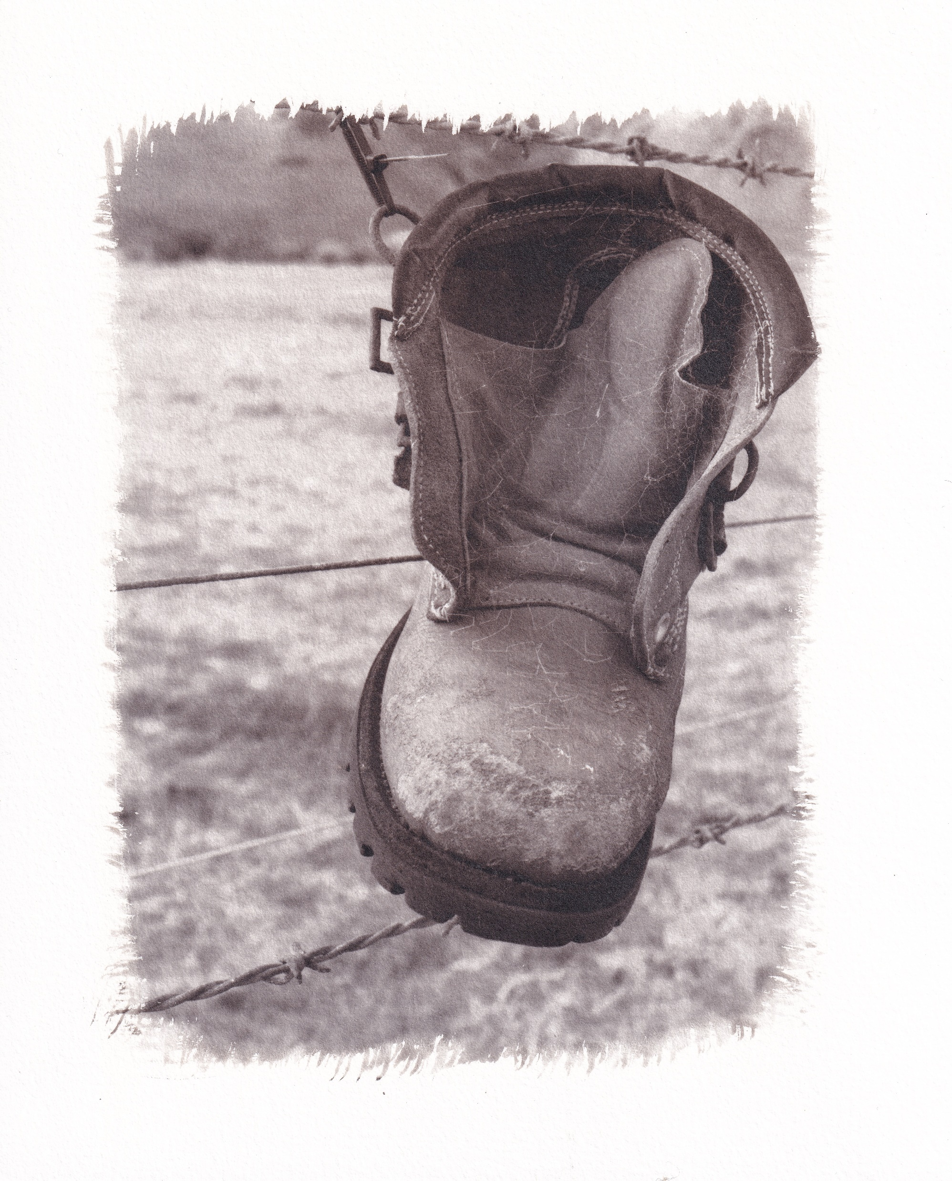

Slide 15
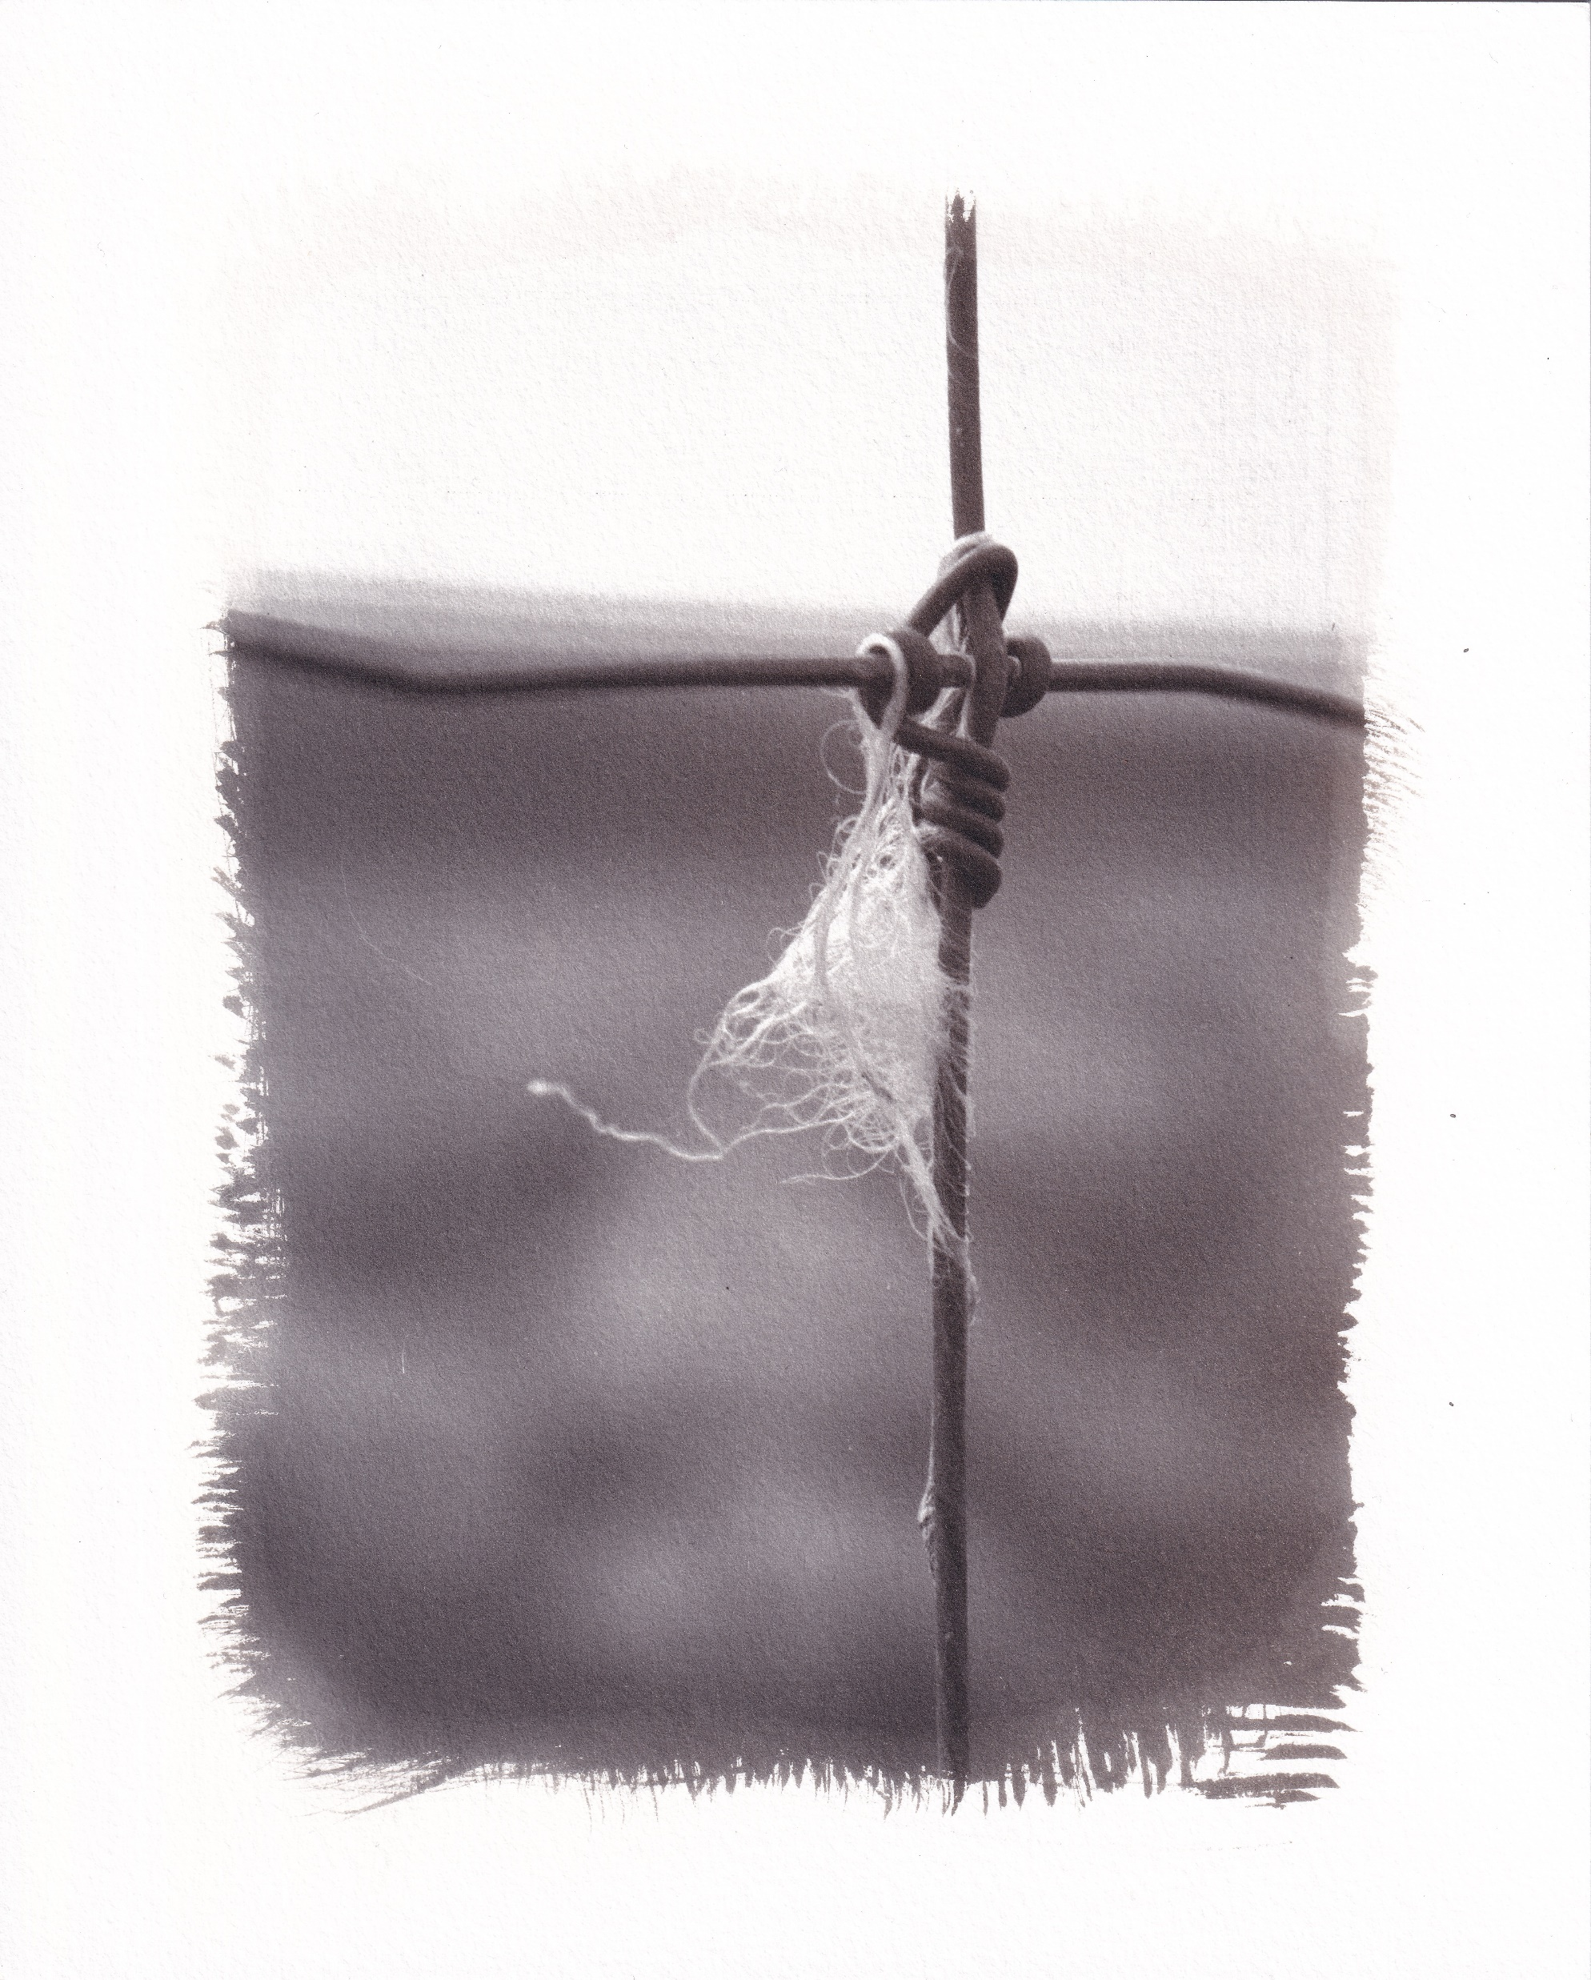

Slide 16
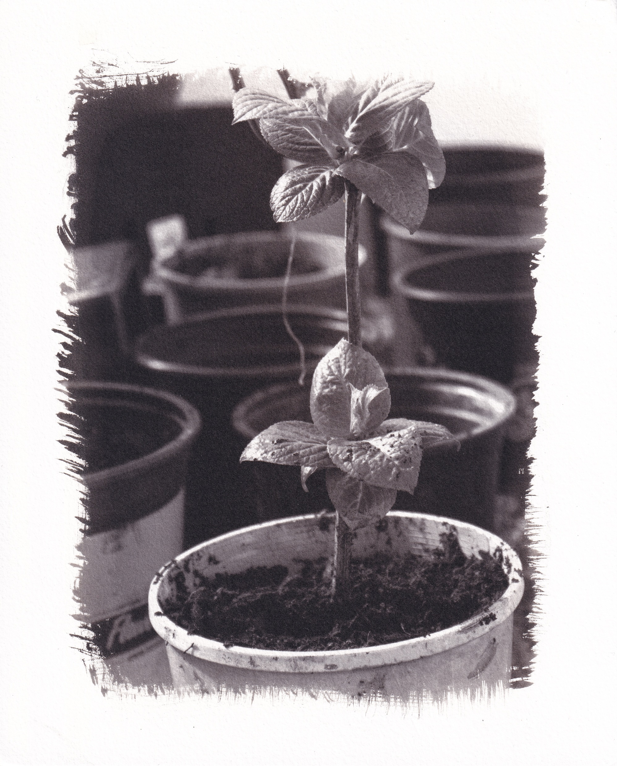

Slide 17
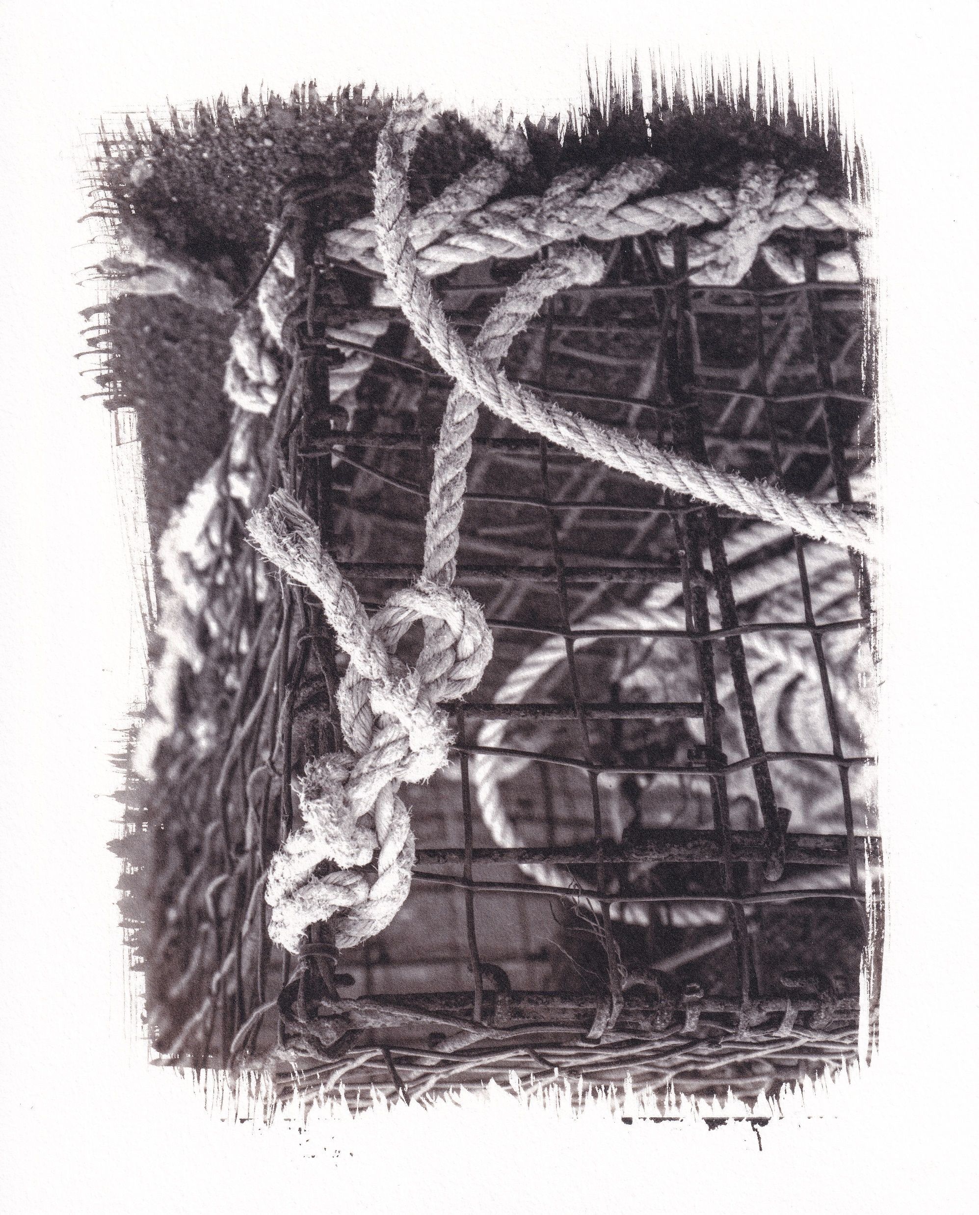

Slide 18
